Slide 1
Health promotion and disease prevention in practice
Pekka Puska, MD, PhD, MPolSc
Ex Director General, National Institute for Health and Welfare (THL), Finland
President, Int. Association of National Public Health Institutes (IANPHI)
Riga 30.9.2015

Slide 2
THE PROBLEM
Heavy burden of NCD’s
Inequalities (geographic, population groups)

Slide 6
NCD prevention
Key to improving contemporary public health
Science base strong
Evidence based strategies
Effective actions
(WHO global NCD action plan)

Slide 7
NCDs are preventable
From a medical point of view NDCs are to a great extent preventable diseases until late in life
Prevention is based on the elimination of lifestyle-related risk factors (tobacco, diet, physical activity, alcohol)
Lifestyles are greatly influenced by social and physical environments
Amenable to policies

Slide 8
NCD prevention pays off
For the individual, successful prevention means avoidance of diseases and related costs, promotion of health and well being, and healthy ageing
For the society and the nation, prevention means reduced disease burden, control of health care costs, increased productivity and a promotion of sustainable and favourable socio economic development
Globally, special responsibilities fall to low- and middle-income countries

Slide 9
Myths about chronic noncommunicable diseases and their prevention
Diseases of mainly old people
Diseases of men
Causes are genetic
Difficult of prevent
Expensive to prevent
Prevention may help the next generation
”Diseases of affluence”
Individual’s responsibility

Slide 10

The effects of prevention (risk factor reduction) are (particularly for cardiovascular diseases and diabetes)
surprisingly rapid and
concern also relatively old ages

Slide 11
Rapid impact of risk factor changes on CHD and diabetes rates
Stopping smoking and AMI risk
Introduction of smokefree restaurants
Cholesterol lowering in lipid trials
Lowering of T2 diabetes rates in diet/PA interventions
Changes on population level (Finland/North Karelia, Poland etc.)

Slide 12

Introduction of smokefree restaurants:
Impact on AMI (Acute Myocardial Infarction) rates
Reviews Amirate reduction
Meyers et al. (2009): -17 % (11 studies)
Mackey et al. (2010): -10 % (17 studies)
Lin et al. (2013): -13 % (18 studies)

Slide 13
DIABETES PREVENTION STUDY, FINLAND
50
Control
40
30
Cumulative incidence of T2D, %
20
Intervention
10
Intervention ceased
0
0
1
2
3
4
5
6
7
8
Lindström et al, Lancet 2006:368;1673-79
11
Follow-up time, years

Slide 14
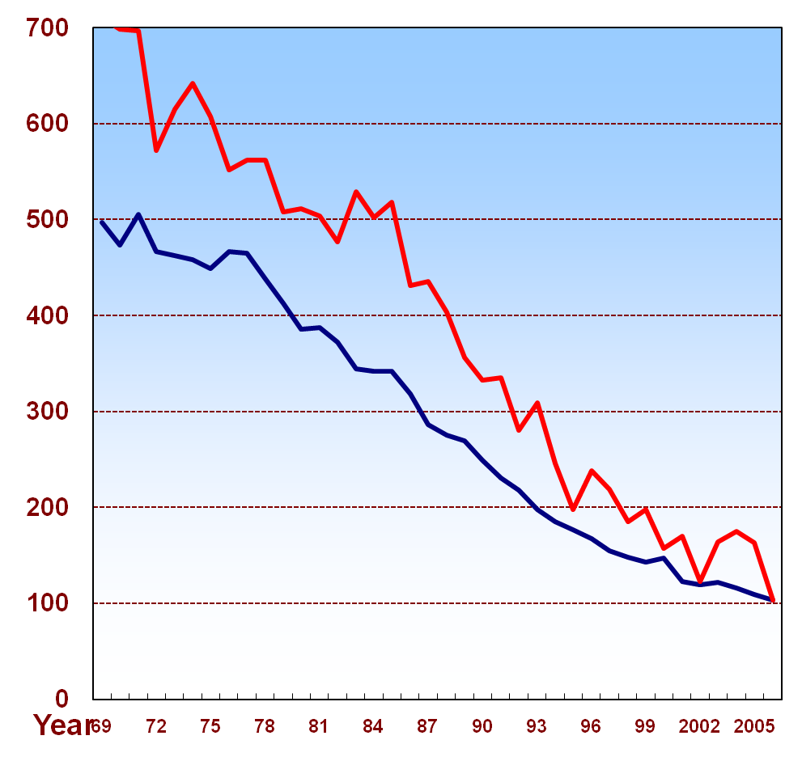
Change in age-adjusted mortality rates
Finland, males aged 35–64 (per 100 000 population)
 | Rate per 100 000
 | 1969-1971 | 2006 | Change from 1969-1971 to 2006
All causes | 1328 | 583 | -56%
All cardiovascular | 680 | 172 | -75%
Coronary heart disease | 489 | 103 | -79%
All cancers | 262 | 124 | -53%
Coronary heart disease
start of the North Karelia Project
extension of the Project
nationally
North Karelia -85%
All Finland -80%
Gain of some 10 healthy years
in Finnish population

Slide 15
Observed and Predicted Declines in Coronary Mortality in Eastern Finland, Men
%
0
-10
-20
Observed
Predicted
-30
Cholesterol
-40
Blood pressure
Smoking
-50
-60
-70
-80
-90
1972
1977
1982
1987
1992
1997
2002
2007
Year

Slide 16
NCD prevention – broad impact
NDC’s, their treatment and the related inequities in health hamper social and economic development
NCD prevention through health promotion and policies in different sectors (”Health in all policies” does not only improve public health but contributes to sustainable social and economic development
NCD prevention helps (in addition to public health) to
  Control health care costs
  Care of elderly
  Increase labour productivity
  Increase general wellbeing

Slide 17
Sihvonen ym. 2003
Healthy and sick years of life expectancy of 65 year old Finns in 1980 and in 2000
Managing basic functions
Subjective health
20
men
women
20
men
women
15
15
10
10
years
years
5
5
0
0
1980
2000
1980
2000
1980
2000
1980
2000
sic / disability
healthy / no disability
sic / disability
healthy / no disability

Slide 18
Economic drivers for NCD prevention
Controlling health care costs
Availability and health of the shrinking working age population
Health and functional capacity of the increasing elderly population
Private sector interests
  workers
  marketing

Slide 19
NCD prevention is not expensive
Influencing lifestyles through health promotion and policies is usually cheap
Even best buy basic prevention services are usually inexpensive and cost effective (WHO)
Example: Raising alcohol tax in Finland during the last 3 – 4 years increased government revenue appr. 400 million euros and reduced alcohol consumption 10 %
Costs of clinical medicine for treatment of CVD, cancer, COPD, diabetes etc. are very high.

Slide 20

Cornerstones of NCD prevention and control (WHO global strategy)
Attention to behavioural risk factors
  Tobacco use
  Unhealthy diet
  Physical inactivity
  Harmful use of alcohol
Monitoring and surveillance of
  Risk factors and diseases
  Preventive actions
Redirection of health services
  Prevention
  Chronic care model

Slide 21
Integrated Prevention
Common Risk Factors (WHO strategy)
TOBACCO USE
UNHEALTHY DIET
PHYSICAL INACTIVITY
ALCOHOL
CVD
DIABETES
CANCER
COPD
MUSCULOSCELETAL
ORAL HEALTH

Slide 22
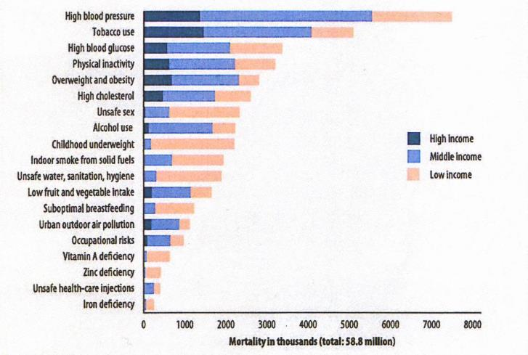
World: Deaths attributed to 19 leading risk factors, by country income level, 2004

Slide 23
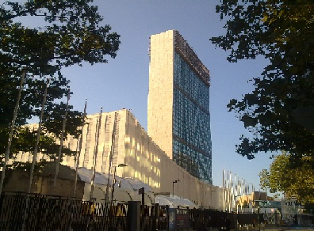
UN high-level summit on NCDs
New York Sept 2011
Preceded by Ministerial Conference in Moscow (April 2011).
Political declaration
Action on global NCD prevention and control”
WHO’s leadership, intersectoral support
European Ministerial NCD
Meeting, Ashgabat 2013

Slide 24
WHO global action plan 2013-20
International cooperation and advocacy
Strengthen national capacity, leadership, governance, multisectoral action and partnership
Reduce risk factors through health-promoting environments
Strengthen and reorient health systems for prevention and control of NCDs
Promote national capacity for research for prevention and control of NCDs
Monitor trends and determinants of NCD and evaluate progress
Global voluntary targets

Slide 25
Global targets (WHO NCD Action Plan)
25 % reduction of avoidable mortality
10 % reduction in harmful use of alcohol
10 % reduction in insufficient physical activity
30 % reduction in mean population salt intake
30 % reduction in tobacco use
25 % reduction in raised blood pressure
Halt the raise in diabetes and obesity
At least 50 % of eligible (=high risk) people receive drug treatment and councelling to prevent heart attack and stroke
In 80 % availability of affordable basic technologies and essential medicines for NCD

Slide 26

3a Reduce risk factors: tobacco
Increase tobacco tax
Completely smokefree indoor places by law
Effective health warnings and media campaigns
Ban all tobacco advertising, promotion and sponsorship

Slide 27
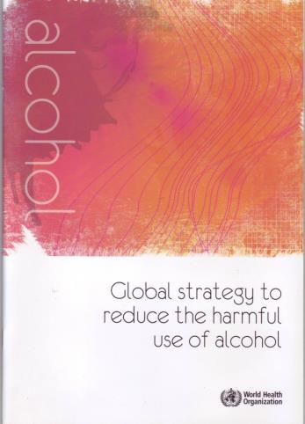
3b Reduce risk factors: alcohol
Increase alcohol tax
Comprehensive restrictions and bans on adventising and promotion
Restrictions in the availability of retailed alcohol

Slide 28

3c Reduce risk factors: unhealthy diet and physical inactivity
Salt reduction through industry and media campaigns
Reduction of saturated fat and replacement of transfats
Public awareness campaigns on diet and physical activity

Slide 29

Redirection of health services
Reorientation and strengthening of health systems
Primary health care:
  ”Now more than ever”
  (WHR 2008)
Special emphasis for NCDs
  Chronic care model
  Preventive practices

Slide 30
6. Monitor and evaluate
Develop national targets and indicators (based on the global ones)
Develop national surveillance monitoring system
  Cause of deaths register
  Cancer register
  Periodic population risk factor surveys
  Monitoring of national actions

Slide 31
NCD FRAMEWORK FOR ACTION/MONITORING
DETERMINANTS
RISK FACTORS
behavioral biological
NCD
Outcome
(death etc)
GENETICS
Health promotion
Prevention
Treatment
SOCIETAL
RESPONSES
(HiAP)
HEALTH SERVICES

Slide 32
Theory and evidence base for effective action to change lifestyles
Medical/epidemiological frameworks:
- choice of the most important risk factors/targets
Behavioural/social theories/frameworks:
- (social) marketing, psychology, social psychology, sociology, social policy, political sciences
Strong and sustained implementation
- leadership, infrastructure, resources

Slide 33
Community intervention model of The North
Karelia Project

Slide 34
COMBING PERSONAL AND PUBLIC RESPONSIBILITIES
Personal Responsibility
”Nobody can take better care of your health than yourself”
Public Responsibility
”Make the healthy choices the easy ones”
(Ottawa charter)

Slide 35
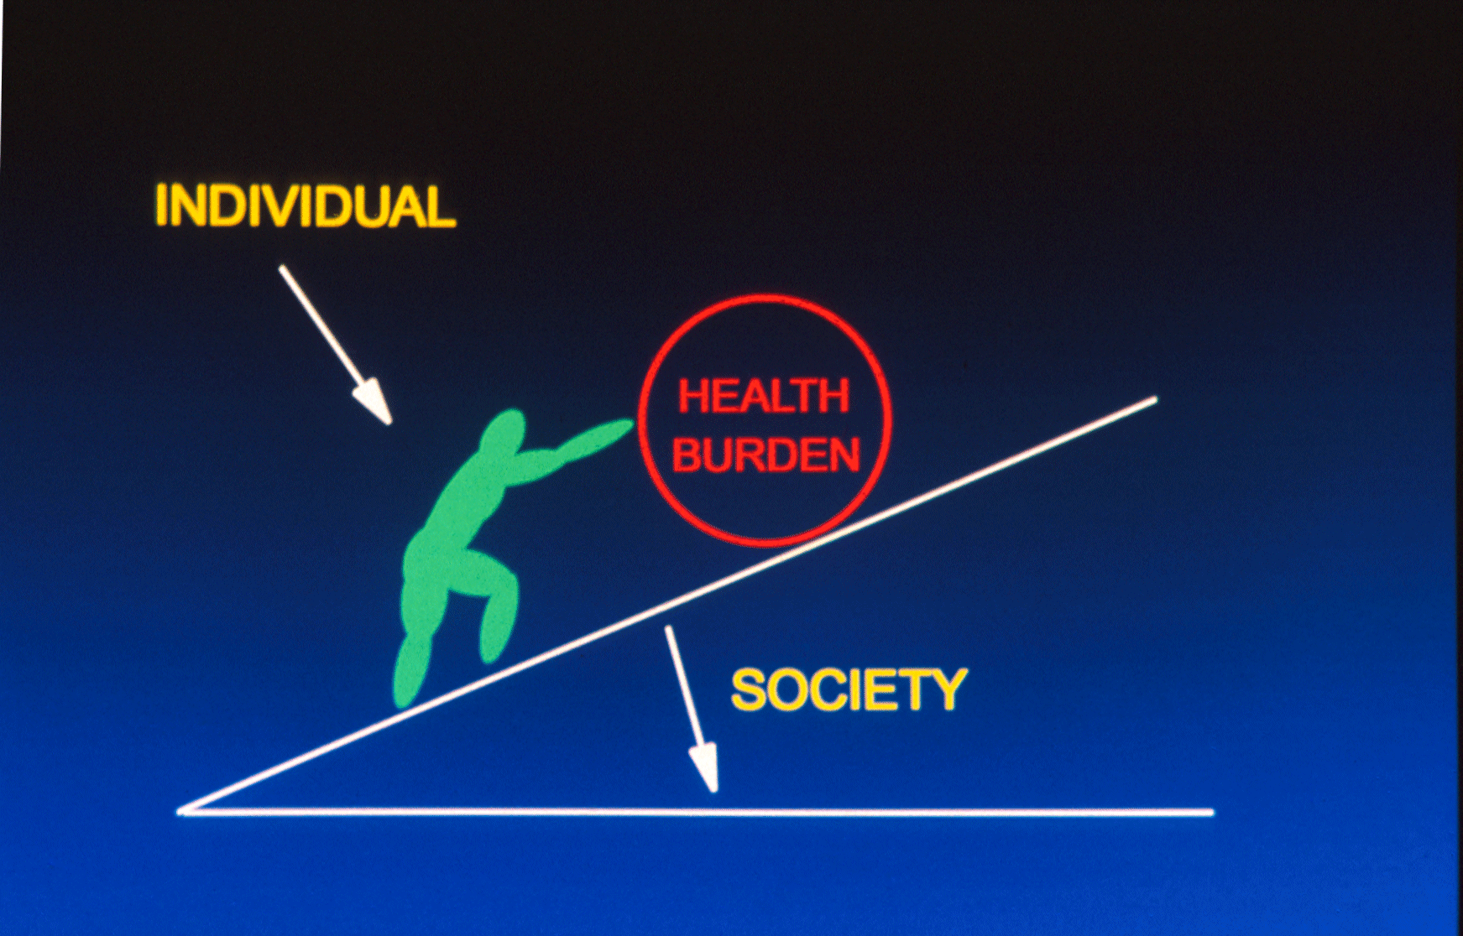
18

Slide 36
PUBLIC RESPONSIBILITY
POLICY INTERVENTIONS

Slide 37
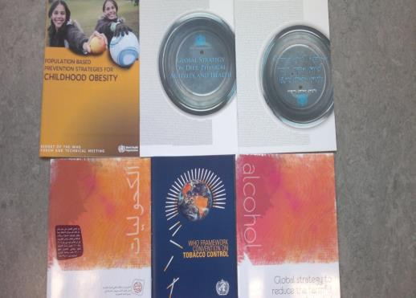
During the last few years a great number of strategies and plans for evidence-based, effective prevention and health promotion have been produced
Many important priorities have been identified

Slide 38
From priorities to implementation
IDENTIFYING
PRIORITIES
“Less is more”
IMPLEMENTING THEM
Policy support
Institutional base
Media support
Resources
Monitoring

Slide 39

Entry points for NCD prevention & control
Diseases
  Vertical, clinical, limited public health impact
Risk factors/lifestyles
  Direct impact on many NCDs, cost-effective at a population level
Determinants
  Basic, general political decisions for health promoting conditions and possibilities

Slide 40
Intersectoral work towards prevention
- ”Health in all policies”
People’s lifestyles are influenced by decisions in different sectors of society (much of them beyond the health sector)
Social change process combining government policies, expert guidance, broad health promotion and mobilization of people
FINNISH EXAMPLES

Slide 41
Important elements of Finnish tobacco policy
No advertizing or sales promotion (since 1978)
Public indoor places, restaurants and work sites smokefree
Pictorial health warnings
Sale to minors (below 18) prohibited
Tobacco products not at display
Sale of smokeless tobacco prohibited
Support to cessation and campaigns
Taxation
PREVALENCE OF DAILY SMOKING 16 %

Slide 42
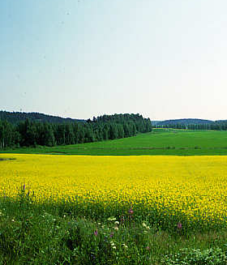
Examples of intersectoral work 1.
Development of Finnish Rapeseed oil
Change in fat content of Finnish cow milk

Slide 43
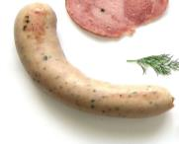
Examples of intersectoral work 2.
Biscuit example:
Leading Finnish biscuit manufacturer (LU Finland Ltd) has removed some 80.000 kg of SAFA by changing the fats used
All trans fats removed and major transfer to rapeseed oil
Meat product example:
HK (Leading Finnish meat company)
since 2007 annually:
40.000 kg less salt
100.000 kg less saturated
fat in their products

Slide 44
Examples of intersectoral work 3.
Berry project in North Karelia
To promote berry farming, product development and consumption
Dairy farmers could switch over to berry farming
Financing from Ministries of Agriculture and Commerce
Finnish Heart Symbol

Slide 45

8th Global WHO Conference on health promotion
“Health in all policies”
From Ottawa to Helsinki (June 2013)
HELSINKI STATEMENT

Slide 46
How to influence policies and the private sector
Directly through presenting rational arguments for evidence-based policies and through identifying win-win situations
Through populations: Opinions, intentions and behavior changes of the population ultimately have a strong influence on politicians (”voters decide”) and the private sector (”consumer is king”)
Monitoring and feedback are important instruments
Use of media for policy change (”behavioral journalism”)

Slide 47
Effective implementation of evidence-based actions
Leadership for a sustained process of social and policy changes
POPULATION
PUBLIC
POLICY
PRIVATE
SECTOR
NATIONAL HEALTH
PROGRAMME

Slide 48
Comprehensive action and partnership for national health promotion and NCD prevention
Health services
Governments, policies (national, local)
Civil society (NGOs)
Private sector
Media
International collaboration (esp. WHO)

Slide 49
Community-based project
(pilot, demonstration, model)
National programme and policies

Slide 50


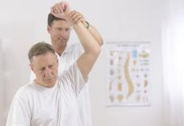
Social change process
People pull policies and
Policies pull people!

Slide 51
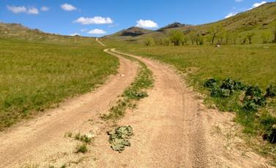
Vision
Prevention of avoidable NCD mortality through policies and broad health promotion leading to the sustainable social change process
”More years in life
– more life in years”
”Health for all”

Slide 52
For succesful prevention and health promotion
Strong leadership combined with
Good partnership
* * *
Do the right things
Do enough of those

Slide 53
Thank you

