Slide 1
Latvia Health Promotion Review
World Bank
Reimbursable Advisory Services (RAS) agreement

Slide 2
The National Latvia Development Plan 2014-2020
Economic breakthrough as an ultimate target
  which means welfare of all population in Latvia and facilitation of national sustainability.
Three priorities are set as the basic principles of sustainable development:
  Growth of national economy
  Growth in supported areas
  Human resilience
    “Healthy and fit for work”: healthy and active lifestyle habits and development of health care system

Slide 3
The National Health Strategy for 2011-2017
Since the new independence in 1991 Latvia has experienced gains in health and average life expectancy,
  but still lags behind its neighbors and other EU countries
Four main diseases areas have been identified in health strategy as the health sector’s top priorities:
  cardiovascular diseases (CVD)
  cancers
  maternal and perinatal health
  mental health

Slide 4
Analytical framework
Goals:
  Are the goals aligned with the disease burden?
Institutional framework:
  Is the institutional framework clearly organized?
Target populations:
  Are the target populations appropriate, are social exclusion groups included?
Health promotion activities:
  Are the planned activities comprehensive and in line with international best practices
Risk factors:
  Are the selected risk factors in line with the disease burden?
Evaluation framework:
  Is the evaluation framework clear and are the indicators appropriate?

Slide 5
Disease burden 2012
Causes of death (WHO NCD Country Profiles):
  Ischemic heart disease (33%), stroke (15%), hypertensive heart disease (4.2%), diabetes (3.4%), lung cancer (3.4%), colon and rectum cancers (2.5%)
Total disease burden, calculated in DALYs,
  CVDs, diabetes, cancers, neuro-psychiatric conditions, other non-communicable diseases, and unintended injuries.
Life expectancy at birth
  69 years among males and 79 years among females
The probability of dying before the age of 70 years, basically preventable mortality
  61% in men and 31% in women
  A quarter of all deaths between ages 30 and 70 years are due to four major non-communicable diseases: CVDs, cancers, chronic respiratory diseases and diabetes

Slide 6
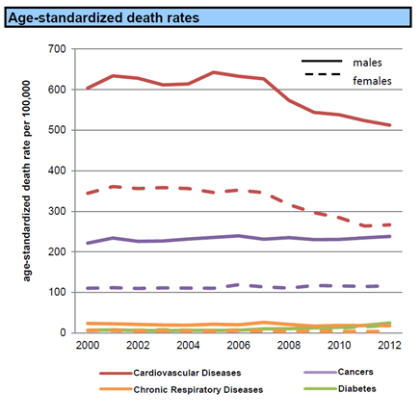

Slide 7
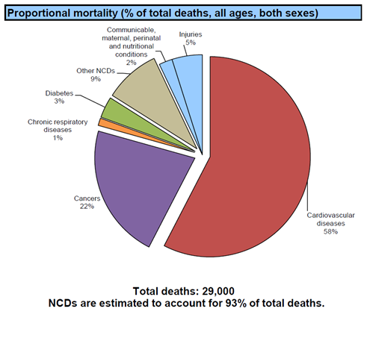

Slide 8
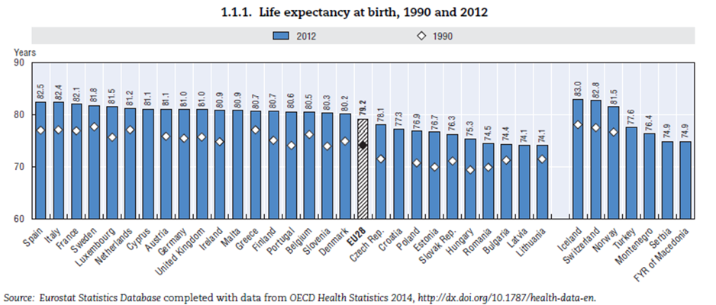

Slide 9
Selected indicators of disease burden in Latvia compared to five countries in the same region
Health indicator | Life expectancy at birth (years) |  | CVD mortality (per 100 000) |  | Cancer mortality (per 100 000) |  | Probability (%) of primordial death
 | men | women | men | women | men | women | men | women
Denmark | 78 | 82 | 140 | 85 | 180 | 140 | 35 | 24
Estonia | 71 | 81 | 395 | 200 | 210 | 100 | 53 | 24
Finland | 78 | 84 | 200 | 100 | 130 | 85 | 34 | 18
Latvia | 69 | 79 | 505 | 280 | 270 | 105 | 61 | 31
Lithuania | 68 | 80 | 450 | 240 | 220 | 100 | 60 | 29
Sweden | 80 | 84 | 170 | 105 | 130 | 100 | 26 | 18

Slide 10
Selected NCD risk factors in Latvia compared to five countries in the same region
Risk factor | Current tobacco smoking (%) |  | Alcohol consumption per capita (liters) |  | Raised blood pressure (%) |  | Obesity (%)
 | men | women | men | women | men | women | men | women
Denmark | 30 | 27 | 16.1 | 6.9 | 30 | 21 | 19 | 18
Estonia | 43 | 21 | 16.2 | 5.3 | 51 | 43 | 21 | 20
Finland | 27 | 20 | 17.5 | 7.3 | 39 | 30 | 23 | 23
Latvia | 46 | 20 | 19.7 | 6.3 | 47 | 42 | 22 | 27
Lithuania | 43 | 25 | 24.4 | 7.9 | 47 | 43 | 25 | 30
Sweden | 25 | 24 | 12.9 | 5.5 | 35 | 27 | 20 | 17

Slide 11
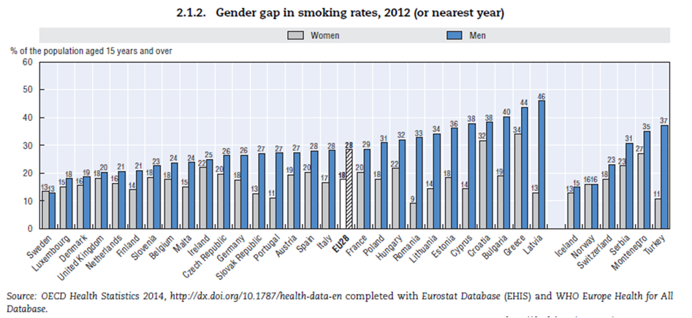

Slide 12
Health Promotion
According to the European Action Plan for Strengthening Public Health Capacity and Services (WHO Regional Committee’s Sixty-two session in 2012) health can be influenced by social and environmental determinants that interact across the life-course with genetics and behaviors.
Health promotion takes a broad view of these determinants and builds on broad definitions of health and well-being. “Health promotion” and “disease prevention” are interconnected.
Health promotion activities have a positive influence on health-affecting behavior and health-supportive environments, which will indeed prevent disease.

Slide 13
Health promotion activities
promotion of changes in lifestyle and behaviors and in environmental and societal conditions, in order to facilitate the development of a “culture of health and well-being” among individuals and the community and to maintain health
educational and social communication activities aimed at promoting healthy conditions, lifestyles, behavior and environments
reorientation of health services to develop care models that encourage health promotion
inter-sectoral partnerships for more effective health promotion activities
assessment of the impact of public policies on health
risk communication
awareness of and action on the social determinants of health and health equity

Slide 14
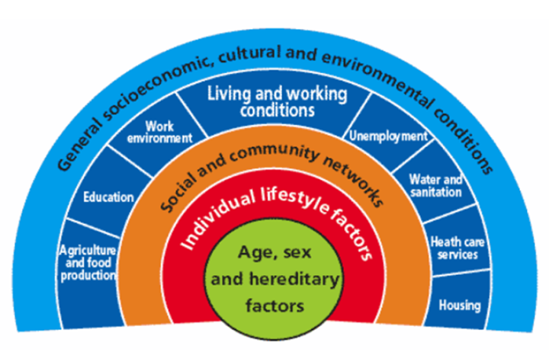
Determinants of health
Dahlgren and Whitehead 1991

Slide 15
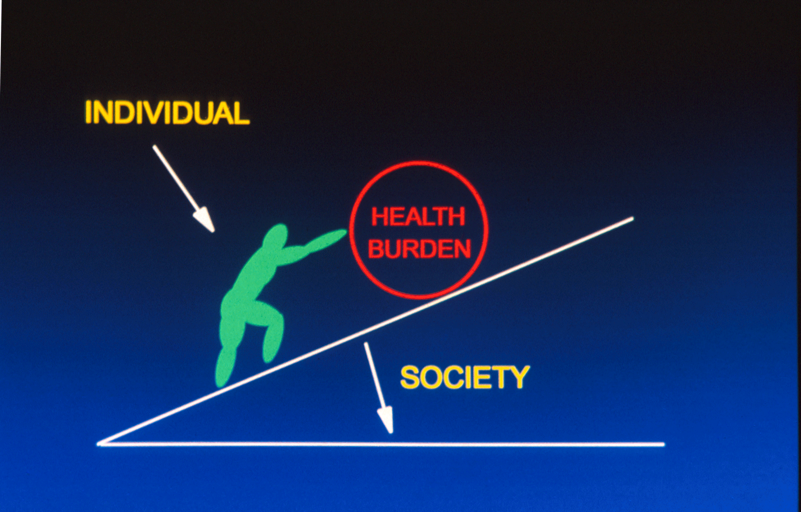

Slide 16
WHO Global Action Plan for Prevention and Control of NCDs 2013-2020
Objectives:
To raise the priority accorded to the prevention and control of NCDs in global, regional and national agendas and internationally agreed development goals, through strengthened international cooperation and advocacy
To strengthen national capacity, leadership, governance, multi-sectoral action and partnerships to accelerate country response for the prevention and control of NCDs.
To reduce modifiable risk factors NCDs and underlying social determinants through creation of health-promoting environments.
To strengthen and orient health systems to address the prevention and control of NCDs and the underlying social determinants through people-centered primary health care and universal health coverage.
To promote and support national capacity for high-quality research and development for the prevention and control of NCDs.
To monitor the trends and determinants of NCDs and evaluate progress in their prevention and control.

Slide 17
Nine voluntary global targets for NCD prevention and control by 2025.
A 25% relative reduction in the overall mortality from CVDs, cancer, diabetes, or chronic respiratory diseases
At least 10% relative reduction in the harmful use of alcohol, as appropriate, within the national context
A 10% relative reduction in prevalence of insufficient physical activity
A 30% relative reduction in mean population intake of salt/sodium
A 30% relative reduction in prevalence of current tobacco use in persons aged 15+ years
A 25% relative reduction in the prevalence of raised blood pressure or contain the prevalence of raised blood pressure, according to national circumstances
Halt the rise in diabetes and obesity
At least 50% of eligible people receive drug therapy and counselling (including glycemic control) to prevent heart attacks and strokes
An 80% availability of the affordable basic technologies and essential medicines, including generics, required to treat major non-communicable diseases in both public and private facilities

Slide 18
Health in all policies (HiAP)
– the need for multi-sectoral action
Most of the determinants of NCDs and their risk factors lie outside of the control of the health sector.
Health sector alone cannot adequately prevent and control major NCDs.
Health behavior, such as tobacco smoking, alcohol drinking, eating and physical activity are neither only individual decisions but strongly related to social, cultural, economic and physical environment.
Multi-sectoral action and collaboration is needed to create enabling environments, so that healthy choices are the preferable and easy choices for individuals, families and all members of the society.

Slide 19
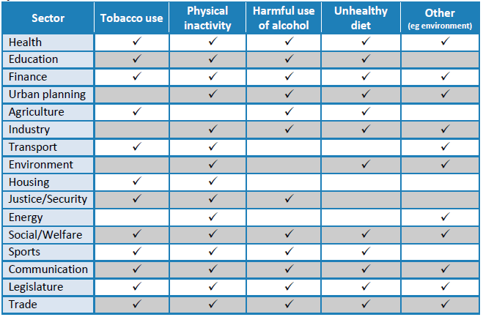
Examples of areas for multi-sectoral action in NCD prevention

Slide 20
Community-based NCD prevention
NCDs have their roots in unhealthy lifestyles or adverse physical and social environments.
Risk factors like unhealthy nutrition, tobacco use, physical inactivity, excessive use of alcohol, and psychosocial stress are among the major lifestyle issues.
The entire population is at risk because of mass elevated risk factors in which individual susceptibility is enhanced by culture, economic factors, and the environment.
Population risk should be amendable to change through community-wide strategies.
The primary tool for implementing a population strategy of prevention is a community-based program.
Community interventions use education and environmental change to promote and facilitate lifestyle and behavior changes needed to address a particular problem.

Slide 21
Population-based and high risk strategies
5 %
70 %
25 %
People with
low risk
factor level
People with average risk
factor level
People with clinically high risk factor level
Individual
risk of CHD
Distribution of people
according to risk factor level

Slide 22
Serum cholesterol distribution in Finland and Japan in 1970’s
Frequency %
mmol/l

Slide 23
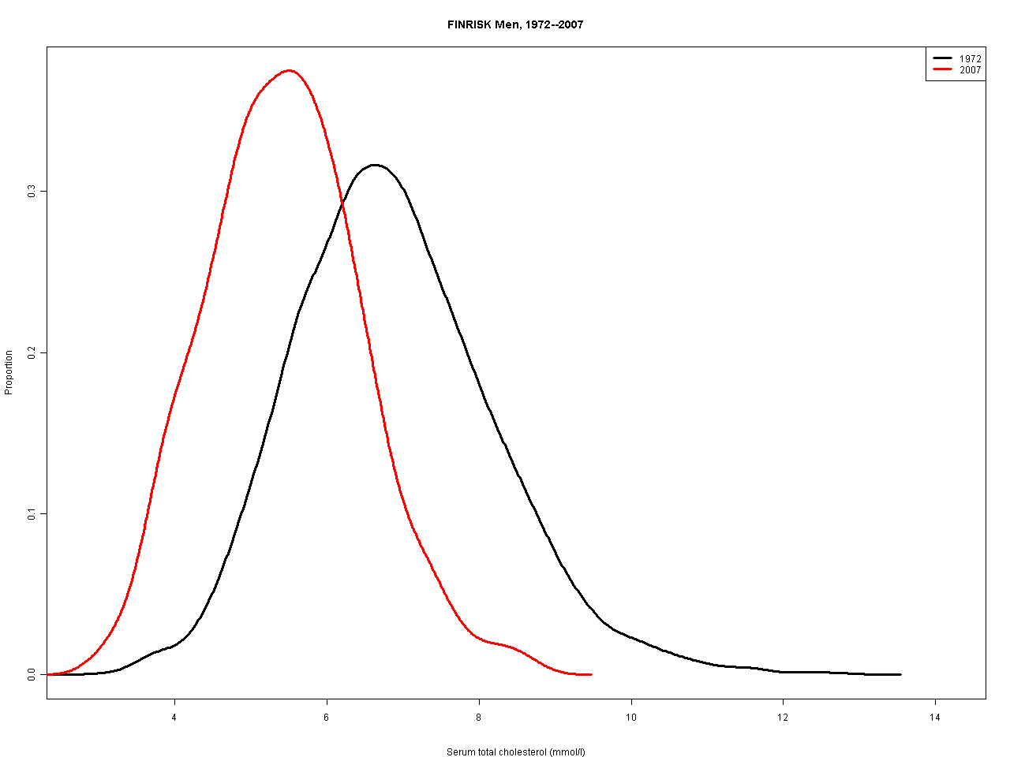
Cholesterol distribution in North Karelia in 1972 and 2007, men

Slide 24
Chow et Int J Epidemiol 2009;38:1580

Slide 25
The Latvian health promotion program: initial analysis
Analysis of the health promotion program with respect to:
  the health promotion policy organization
  the planned health promotion activities (measures used and target groups), and
  the evaluation framework (indicators and proposed levels of analysis), highlighting potential areas for improvement.
The analysis is done in relation to the epidemiological situation and disease burden in Latvia, and the international guidelines and best practices.

Slide 26
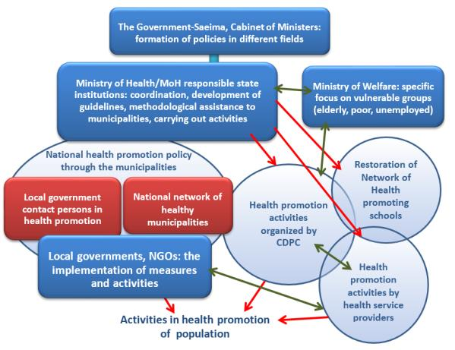
Health promotion policy organization

Slide 27
Planned health promotion activities
The health promotion plan for the period 2014-2020 includes 36 different programs having a total budged over 50 million Euros funded by the EU.
The topics of the program are divided into the following broad areas:
  Reducing spread of addictive substances (alcohol, drugs and tobacco) and processes (games of chance, computer addiction etc.)
  Healthy food promotion
  Promotion of physical activities in society
  Reproductive health
  External mortality causes, trauma prevention
  Oral health
  Infectious disease prevention
  Mental health (stress management, mental overload, workaholics etc.)

Slide 28
Main planned activities:
thematic lectures and seminars
organizing interest groups
development of peers education programs
production of educational short movies
interactive educational classes
activities in municipalities aimed at popularization of particular behavior or opportunities
elaboration of addiction prophylaxis programs and implementation in educational establishments
organizing summer camps
production of informative materials (posters, books, brochures, AV-materials)
complex public information materials.

Slide 29
Comments: planned activities
Activities are related to information dissemination as the main methodology for behavioral change.
  Broader social, economic and environmental approach is needed.
  For effective reduction of main NCD risk factors and disease burden, creation of health promoting environment is necessary.
Tools for environmental change include tax and price policy, legislation and regulation, environmental planning, collaboration between different government sectors and public-private partnership.
Health promoting environment, making health choices easy (and affordable) ones is also effective for reducing inequality in health.

Slide 30
Role of health services
Even though most of the NCD prevention is done outside of the health sector, participation and support of doctors and other health professionals is critical for success.
  Health professionals are usually trusted experts and opinion leaders in the community they are working.
  Health services do risk factors screening and counselling of healthy lifestyles is part of the treatment of every patient.
    Particular emphasis should be put on smoking cessation support among smokers.
  Health services can also provide targeted services for vulnerable groups, for example risk factor screening and health education for unemployed people.

Slide 31
Evaluation framework
The planned evaluation framework includes 22 indicators and a separate plan for assessment of health at local level.
The suggested indicators are classified in six groups: general (one indicator), CVD (4 indicators), oncology (3 indicators), mental health (6 indicators), perinatal health (3 indicators) and socioeconomic situation (3 indicators).
Most of the indicators are related to mortality, morbidity and use of health services.

Slide 32
Comments: evaluation framework
Even though the indicators are important for assessment of the health situation in Latvia, they are not suitable for evaluation of the planned health promotion program at this stage.
Instead of morbidity and mortality, main emphasis needs to be put for monitoring of health behavior and levels of risk factors, and related knowledge and attitudes.
  In these mediating factors change can be seen in a few years but at least 5-10 years is needed to see the effect of the program in mortality.
To be able to monitor the health behavior and physical and biological risk factors, a population-based monitoring system needs to be established.
  European Health Information (EHIS) and European Health Examination Surveys (EHES) protocols may be used as models for the surveys. Both survey protocols can be modified for Latvian context.
  Monitoring of health behavior – particularly smoking habit – is recommended to be done annually or at least biennially by using health interview or questionnaire survey. Data on physical and biological risk factors should be collected in every 4 to 5 years.

Slide 33
Criteria for assessment of health at local level
The proposed “Criteria for assessment of health at local level” is technically demanding, and most probably not feasible, and some of the indicators are not relevant in Latvian context.
For calculation of morbidity and mortality indicators, Latvian municipalities have too small population.
  Even though the needed data would be available –which may not be the case – the number of event in each municipality (unit of analysis) will be too small (and prone for random variation) for any meaningful statistical comparison.
Therefore, morbidity and mortality indicators can be used only regional and national level and
  the suggested UK evaluation model is not feasible in the Latvian context.
In analyzing population-based risk factor data, the needed sample size (power) varies depending on the variable in interest but is usually at least 500 for each cell (area, sex, age-group, etc.).
  In the EHES protocol the recommended minimum sample size is 4000 for one country.

Slide 34
Monitoring of health promotion activities at municipality level
Process monitoring could be done annually by collecting data from the municipalities including the following indicators, for example:
    the municipality has full/part time health promotion staff
    the municipality has a delegated health promotion contact person
    the municipality has health promotion policy planning document
    health promotion is included in the local (multi-sectoral) planning document in the municipality (and the municipality has a multi-sectoral health promotion coordination mechanism)
    the municipality is participating in Healthy Municipalities/Cities program and the Healthy Schools program (and number of participating schools)
    summary data on health promotion activities in the municipality
    budged for health promotion in the municipality
  It should be noticed, that the Latvian municipalities and cities vary very much in size. Riga is a metropolitan city whereas other cities and municipalities are small. To assess health promotion activities and resources in Riga, a specifically designed evaluation tool may be needed.

Slide 35
Recommendations: Organization
Health promotion policy organization in Latvia with its three levels – political (MoH), national technical (CDPC) and local (local governments and the network of contact persons in municipalities) – is basically clear and sound.
  Organizational stability and sufficient resources needs to be guaranteed
  Permanent structures for inter-sectoral collaboration need to be created for both national and local level.
  Collaboration and mutual understanding between MoH and Ministry of Welfare is necessary.
The mandate of CDPC is critical for coordination and technical support for health promotion and diseases prevention.
  Broad mandate: health promotion and protection, diseases prevention, and monitoring of risk factors and health situation in the population, and including both infectious and non-communicable diseases (and environmental health).
  Legal background and sufficient resources
  Coordination of health promoting network
xx

Slide 36
Recommendations: Activities
In health promotion, environmental change needs particular attention.
  Even though health behavior, such as smoking, alcohol consumption and physical activity is an individual decision, it is largely affected by social, cultural, economic and physical environment.
  Environmental change is also a tool to improve health equity. Healthy choices should the easy and affordable ones.
The strategy needs to have clearly defined targets and indicators for monitoring. WHO Non-communicable Disease Action Plan and its nine voluntary targets, and related 25 indicators, adjusted for the Latvian context, could be used as the foundation for the strategic planning.
  Neighboring Baltic and Nordic countries could be used for benchmarking.
Inter-sectoral collaboration and multi-sectoral action for health need to be strengthened both national (government) and local (municipality) level.
  Collaboration between MoH and Ministry of Welfare is particularly important but involvement of the other sectors is also necessary.
  Furthermore, involvement of non-governmental actors, such as community organizations, professional societies and private business sector is needed.
Financing of health promotion activities is not clear and needs to be clarified. An earmarked share from tobacco and alcohol tax is an option to collect funding for health promotion.

Slide 37
Recommendations: Activities/2
In health promotion, a comprehensive approach is needed including:
  health education and communication
  environmental change
  community participation
  multi-sectoral action
  involvement of private sector
  reorientation of health services
Collaboration and communication within the health promotion network needs to be strengthened:
  web-based tool
  newsletter
  regular meetings and training events
  annual health promotion conference
  needed budged allocation
Topics of the planned health promotion activities are adequate and based on the available epidemiological data.
  Reduction of tobacco smoking
  Reduction of harmful alcohol consumption
  Promotion of healthy diet
  Promotion of physical activity

Slide 38
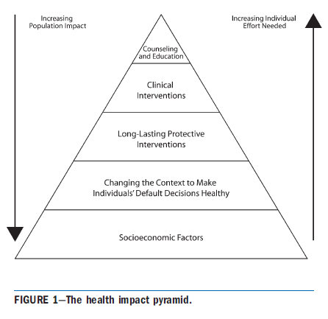
Public health impact pyramid
Frieden TR. Am J Public Health 2010;100:590–595.

Slide 39
Recommendations: Evaluation
A comprehensive health promotion evaluation framework needs to be established, and the roles and responsibilities of different organizations (MoH, Statistical Office, CDPC, Cancer Registry, academia, municipal authorities, etc.) clarified.
  Available data (on health behavior, risk factors, knowledge and attitudes, morbidity and mortality, use of health services, etc.) need to be analyzed and a plan for future data collection and monitoring done.
Main emphasis on outcome evaluation should be put on continuous monitoring on health behavior and physical and biological risk factors.
  Health behavior monitoring should be done every year or biennially, and assessment of the levels of other risk factors every four to five years.
  Standardized monitoring tools, such as EHIS, EHES, STEPS, GATS and GYTS, should be used. Additional components relevant for the Latvian context can be included in the surveys.
Due to small population in most Latvian municipalities, outcome evaluation needs to be done based on larger units, nationally or if relevant regionally.
  In addition to geographic location, data need to be analyzed by gender, age-group and socioeconomic position.
  Due to needed sample size, sub-group analyses may be done at national level only. Assessment of health indicators (risk factors, morbidity, mortality) is not feasible and local level but local level process evaluation may be meaningful.

Slide 40

Thank you!

