Slide 1
COVID certificates
in Ukraine

Slide 2
COVID certificates - certificates of COVID-related safety of a human:
Regarding vaccination
Regarding negative test results
Regarding recovery from COVID
The goal is free and safe
movement of citizens during the COVID pandemic
Developed following the requirements of the European Commission's EU Digital COVID Certificate and the WHO Smart Vaccination Certificate
Will be used in parallel with the International Vaccination Certificate

Slide 3
Type of certificates | Validity period
Regarding vaccination | 180 days | +
Regarding negative COVID PCR test | 72 hours | +
Regarding recovery from COVID (positive PCR followed by negative PCR) | 180 days | +
Other possible options: clinical recovery (medical report) antigen or antibody tests others |  | ?

Slide 4
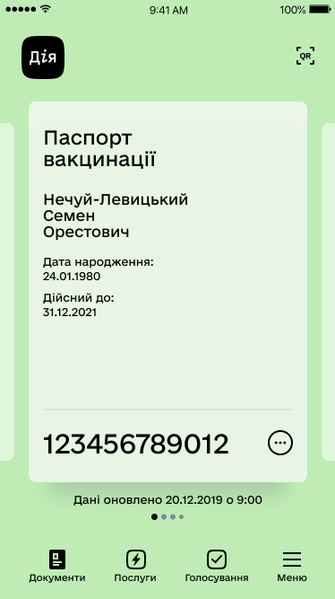
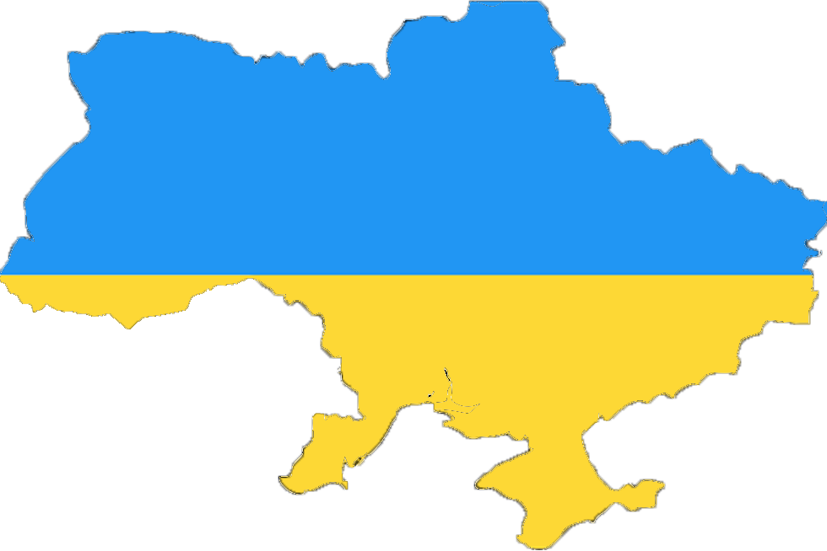
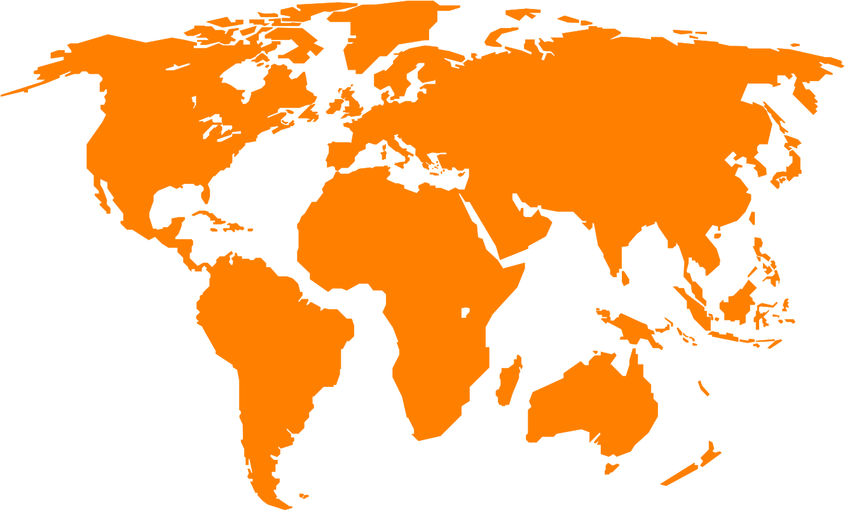
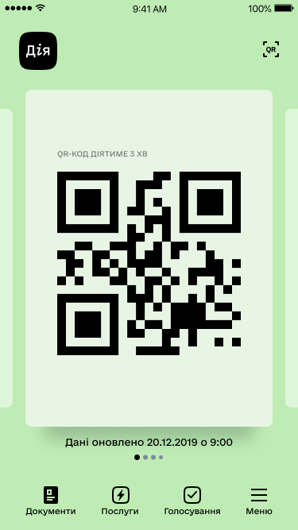
Use cases
Diia
COVID certificate
COVID certificate
Nechui-Levytskyi
Semen
Orestovych
COVID certificate valid thru: 21/31/2021
Disease / pathogen: SARS-Cov-19
cafeteria and restaurants
cinemas, libraries, museums, public events
schools and universities
trains, planes and public transport
Date of birth:
Date of expiry:
with medical data
in a foreign language
* in accordance with international requirements
Data updated on 12/20/2019 at 9:00
Code will be valid for 3 minutes
Documents
Services
Voting
Menu
Full name:
Diia Nadiia Volodymyrivna
Date of birth:
Diia
Passport number:
Dose 1 / 2
Vaccine:
QR code will be valid for 3 minutes
Manufacturer:
Vaccine number:
Date:
Clinic:
Country:
Ukraine
Dose 2 / 2
Vaccine:
Manufacturer:
Vaccine number:
Data updated on 12/20/2019 at 9:00
Date:
Clinic:
Documents
Services
Voting
Menu
Country:
Ukraine

Slide 5
COVID certificate is valid thru: 21/31/2021
Diia
Disease / pathogen: SARS-Cov-19
Certificate ID
COVID certificate
Nechui-Levytskyi
Semen
Orestovych
Diia
QR code will be valid for 3 minutes
QR code for certificate verification
Date of birth:
Code will be valid for 3 minutes
Date of expiry:
Full name:
Diia Nadiia Volodymyrivna
Data updated on 12/20/2019 at 9:00
Documents
Services
Voting
Menu
Date of birth:
Passport number:
Personal information
for the owner identification
Dose 1 / 2
Vaccine:
Manufacturer:
Medical data
for travelling abroad
Vaccine number:
Data updated on 12/20/2019 at 9:00
Date:
Clinic:
Country:
Ukraine
Documents
Services
Voting
Menu
Dose 2 / 2

Slide 6
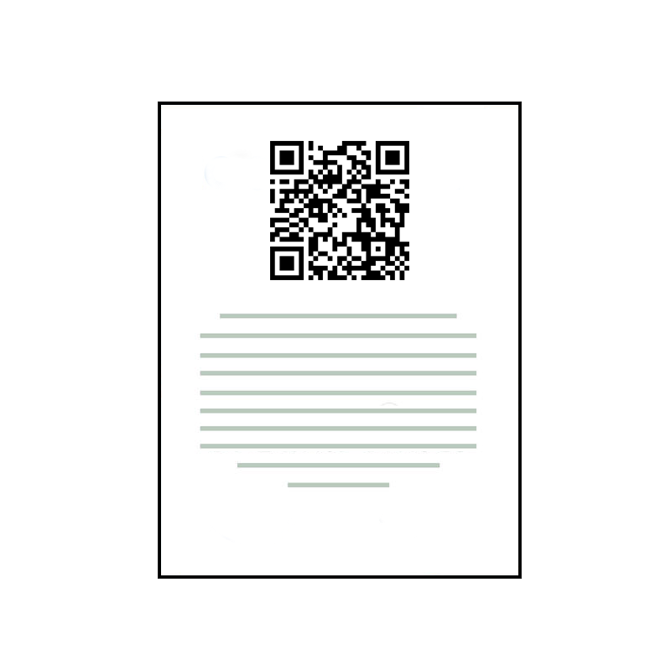
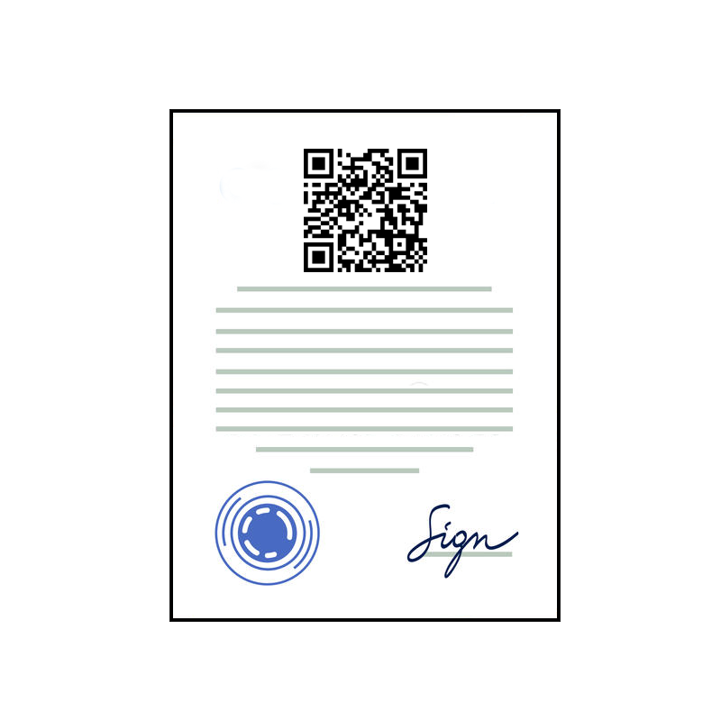
Medical
service
Certificate request
Certificate display
Diia
2021-07-01
V 1.0
online
Application
treatment, testing or vaccination
Portal
2021-09-01
V 2.0
offline
Administration Service Centre
Paper

Slide 7
Electronic Healthcare System (eHealth)
The only state web portal
of electronic services
Centralized system used to store medical data.
Certificates will be generated based on primary medical data.
It will be used to store COVID certificates.
It consists of a portal and an application.
"One-stop shop” for citizens of Ukraine in the context of public services.
It will be used both – to initiate generation and to display certificates.
31 mln. registered patients
125 thousand doctors
More than 10 mln. users
5 mln. with the current version of the app
41.5 mln. – population of Ukraine

Slide 8
Validation via Diia
(QR code scanning)
Validation via other countries scanners and apps
Presentation
Presentation
Level of reliability during certificate check

Slide 9
Project schedule
April | May | June | July | August | September
preliminary analysis
technical development on the side of eHealth, Diia and SBGS
start of the project
technical development
on the side of medical systems and Administration Service Centre
fundraising
process modeling
technical consultations with the EU
establishing relations with EU countries and other countries
regulatory control in Ukraine

Slide 10
Distribution of responsibility by areas of activity
Ministry of Health - regulatory control
NHSU - register of eHealth COVID certificates, integration with external systems (Diia, medical systems, Administration Service Centre), registration of vaccinations with WHO
Ministry of Digital Transformation of Ukraine - a request to generate, generation, display and validate COVID certificates through Diia, Country Signing Certificate Authority
The Ministry of Foreign Affairs - bilateral agreements on the recognition of digital certificates with the EU and other countries
SBGS - verification of foreign digital certificates when crossing the border with Ukraine
Ministry of Digital Transformation of Ukraine - general coordination of the project

