Slide 1
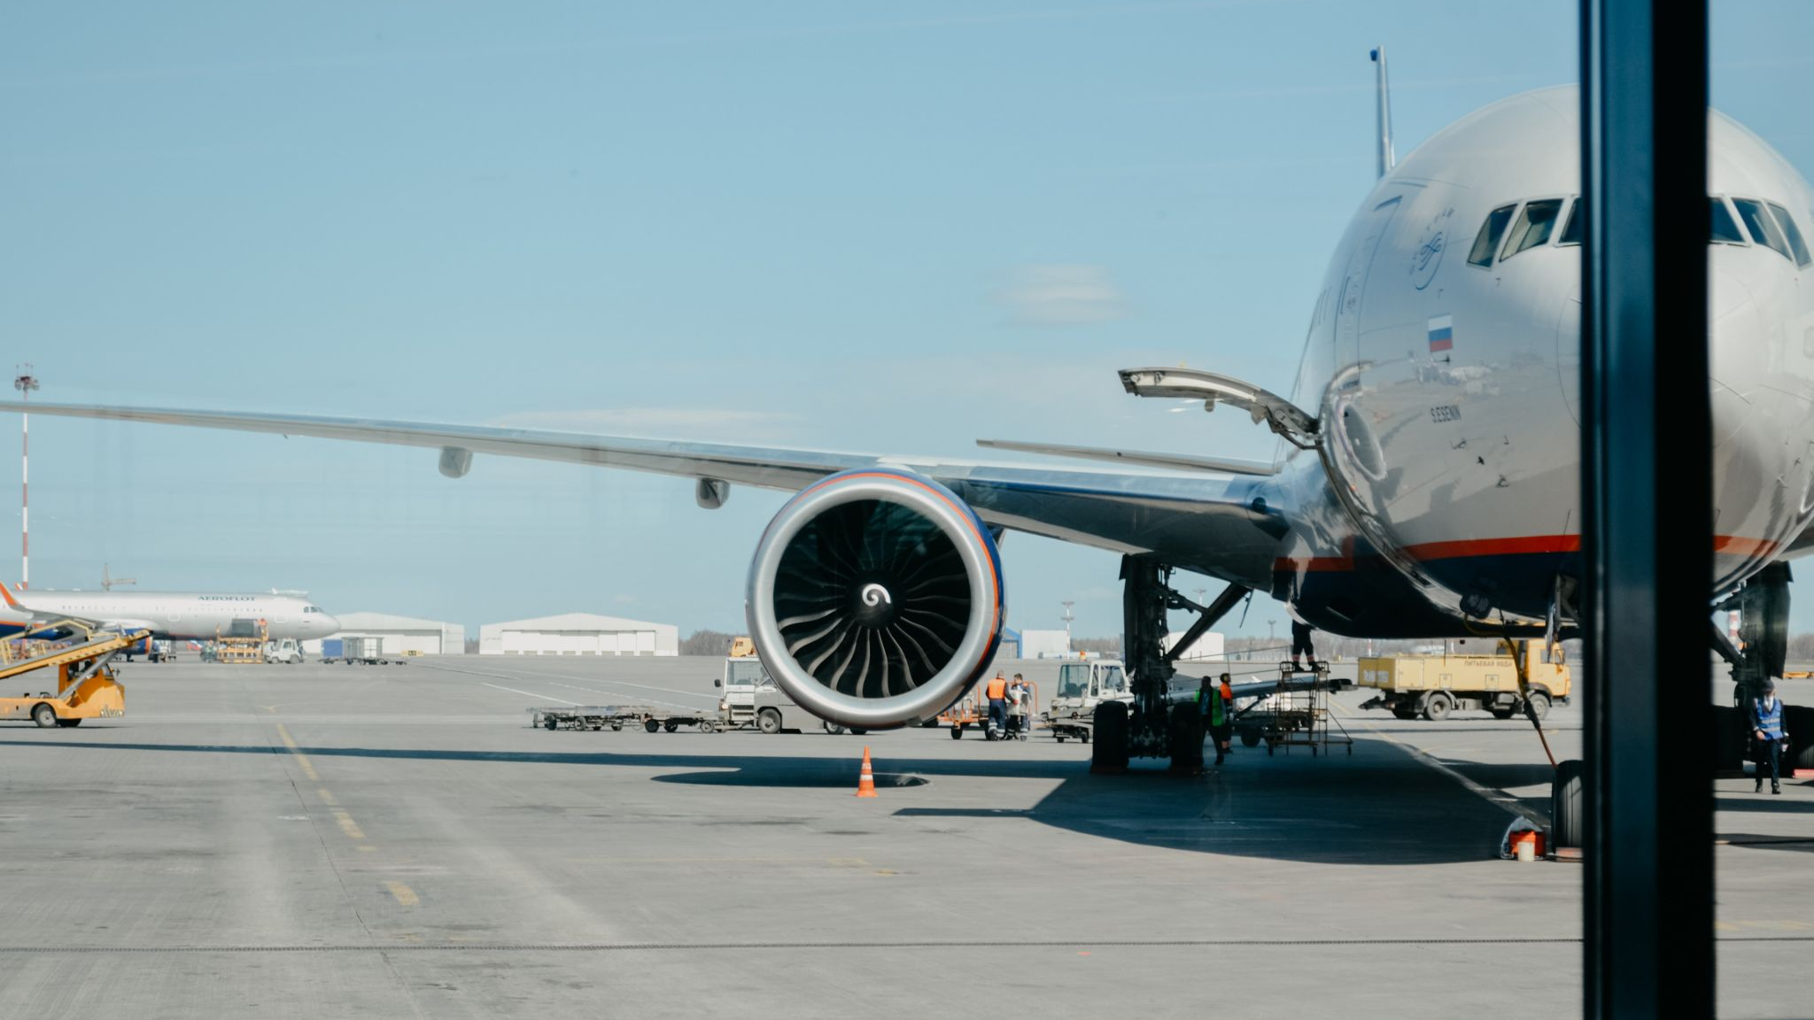
Covid Vaccination Status
Outbound International Travel
3 June 2021

Slide 2
England Covid Status Products
NHS App and Letter

Slide 3
Summary
Product Proposition
The UK government committed to the reopening of safe, secure international travel, from 17 May
NHSX have launched both digital and non-digital certification solutions to allow English individuals to show their Covid status for the purposes of international travel
The Devolved Administrations are also working on solutions.
The products will show vaccination status
Digital Product Features
Detailed vaccination records inline with the World Health Organisation (WHO)’s draft international standards set out in the Interim guidance for developing a Smart Vaccination Certificate.
A QR code, with scope to increase functionality as international standards develop
Secure log in, to minimise fraud-risks
Continued iterative development

Slide 4
NHS App
17 May | Release 1: National Launch

Slide 5
NHS App
17 May | Release 1: National Launch

Slide 6
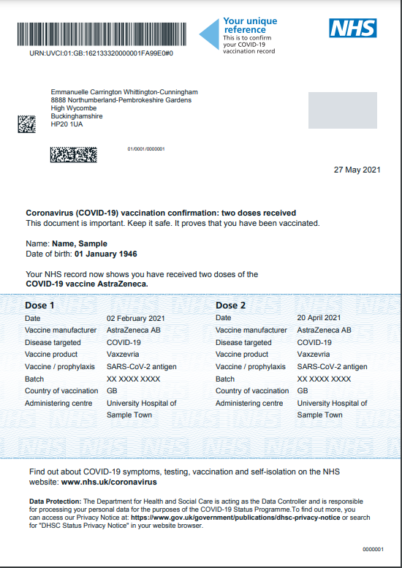
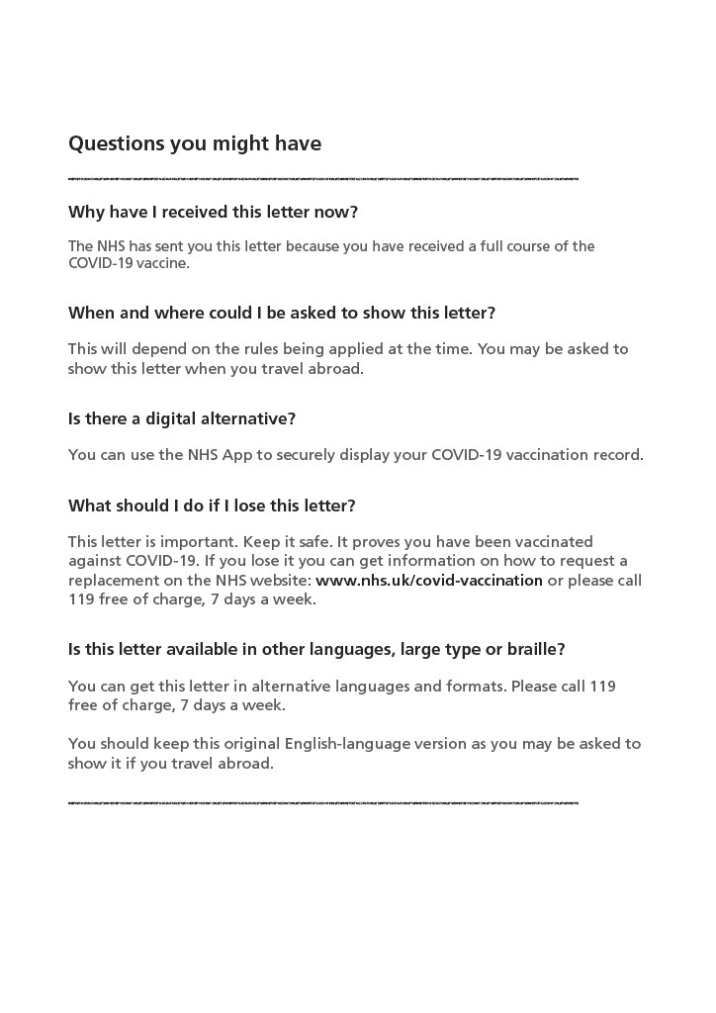
Non-Digital
Inclusive Letter
17 May National Launch:
119 service to request a letter / alternative copies in larger font, braille or other languages
Security features:
1. Thermochromic ink (colour changes with heat)
2. Micronumbers under barcode
3. Unique reference
4. COPY patch when photocopied

Slide 7
Scotland and Wales Covid Status Products
Letters

Slide 8
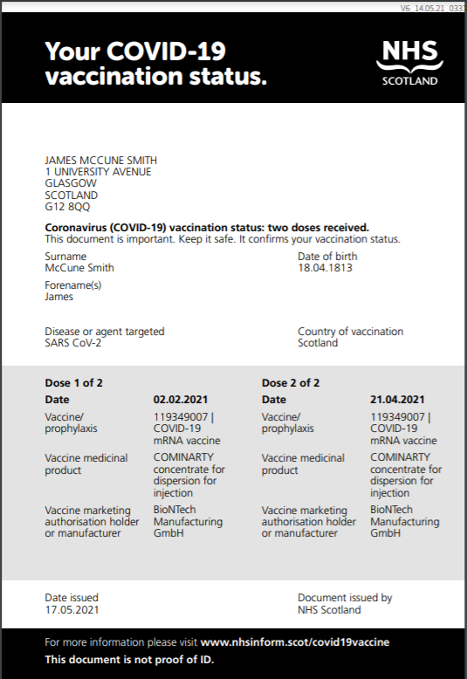
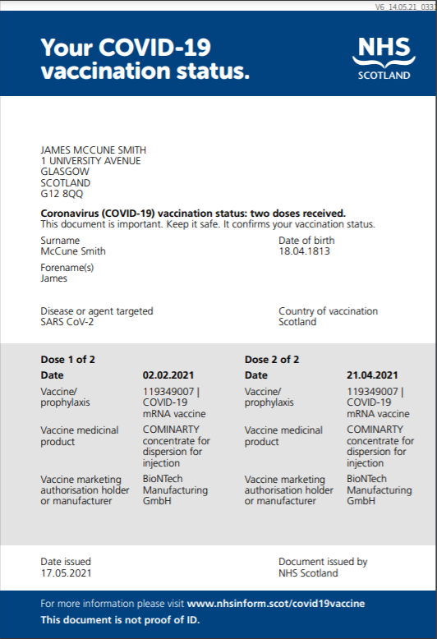
Scotland
Inclusive Letter
19 May National Launch:
Phone service to request a letter. Or go online to request a print a letter.
Any previously-printed letters should not be accepted
Security features:

Slide 9
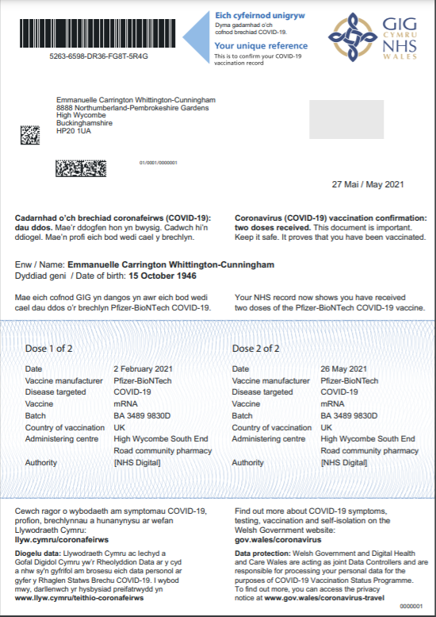
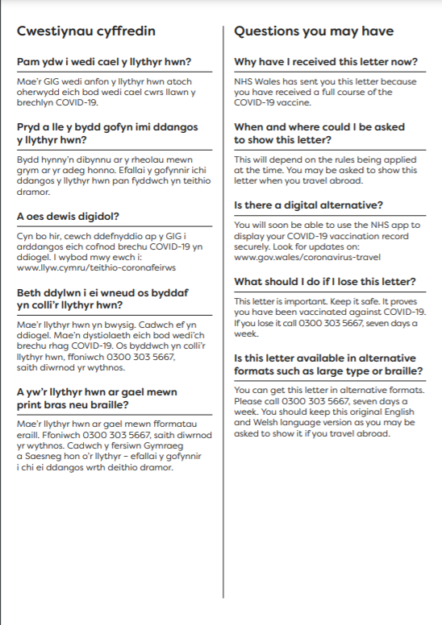
Wales
Inclusive Letter - bilingual in Welsh and English
24 May National Launch:
Phone service to request a letter
Security features:
1. Thermochromic ink (colour changes with heat)
2. Micronumbers under barcode
3. Unique reference
4. COPY patch when photocopied

Slide 10
Crown Dependencies Covid Status Products
Letters

Slide 11
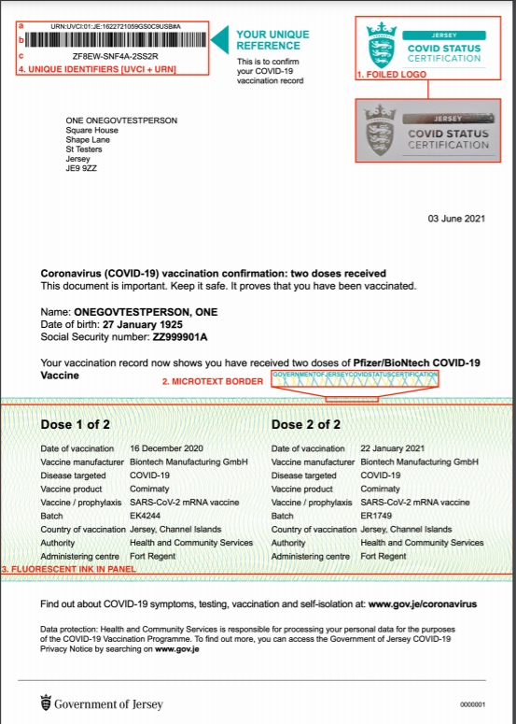
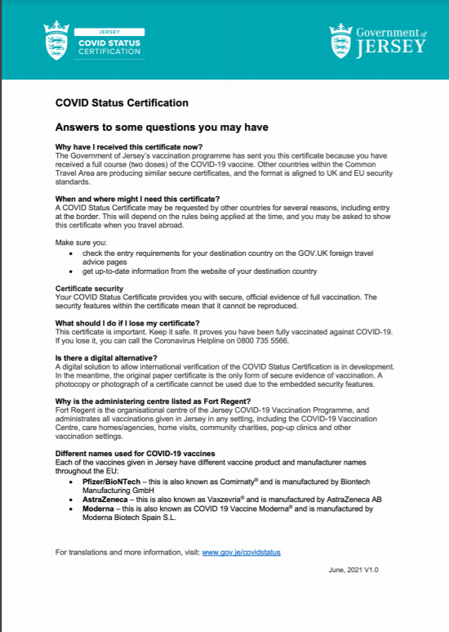
Jersey
Inclusive Letter - back of letter blank, FAQs printed separately
Letters will be proactively sent to all citizens with a vaccinated status. Citizens should start receiving them from 10 June
Security features:
1. Foiled Jersey COVID Status Certification logo
2. Microtext bordering the top and bottom margins of the vaccine panel
3. Fluorescent ink across vaccine panel and behind vaccination information
4. Document identifiers
a. UVCI
b. Barcode
c. URN

Slide 12
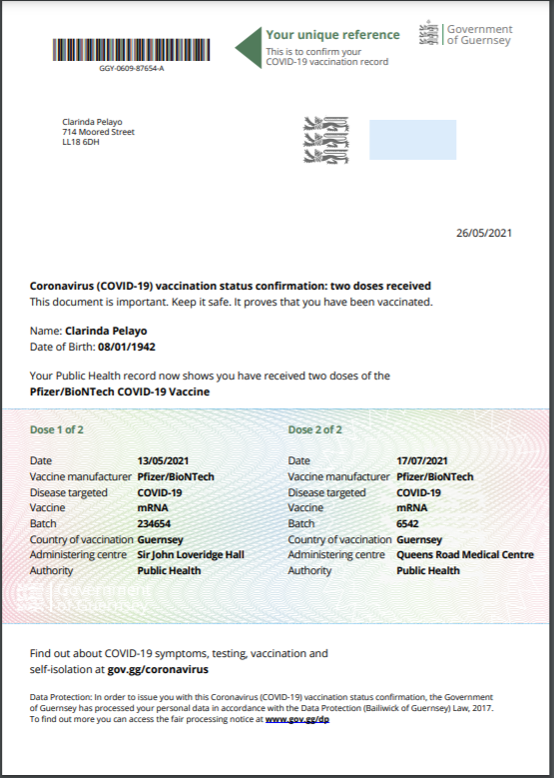
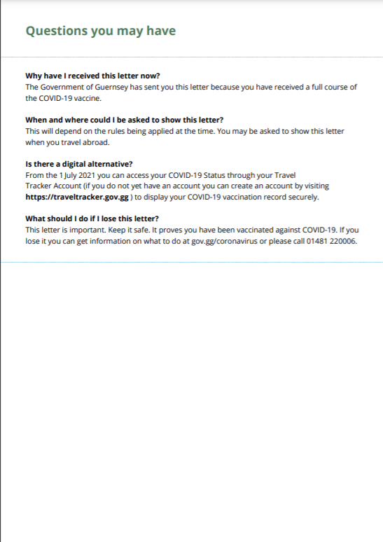
Guernsey
Inclusive Letter
Letters are being proactively sent to all citizens with a vaccinated status during June 2021
Security features:
A unique reference code displayed under and within the barcode
Watermarked paper (with the Guernsey lion)
COPY Pantograph that displays the word COPY if letter is copied
Hologram alongside the pantograph (three silver Guernsey lions)
Colour Guilloche with logo and crest embedded
Microtext border around vaccination data held within the Colour Guilloche
Microtext line bordering the text on the back page

